Slide 1
TUGAS diskrit
Galih Anggoro Prasetya
Teknik Informatika
22205018

Slide 2
Operasi beda setangkup

Slide 3
Diket :
A = {1,2,3,5,6,8,9,10}
B = {2,7,8,11}
C = {1,3,5,7,9,11}
D = {0,1,2,5,6,7,9,12}
A ⊕ C = ?
Jawab :
A ⊕ C = {1,2,3,5,6,7,8,9,10,11} = {2,6,7,8,10,11}

Slide 4
Diket :
A = {1,2,3,5,6,8,9,10}
B = {2,7,8,11}
C = {1,3,5,7,9,11}
D = {0,1,2,5,6,7,9,12}
A ⊕ D = ?
Jawab :
A ⊕ D = {0,1,2,3,5,6,7,8,9,10,12} = {0,3,7,8,10,12}

Slide 5
Latihan SOAl

Slide 6
Diberikan himpunan-himpunan berikut:
A = { 1, 2, 5, 6, 7, 11, 12, 13, 15, 18, 20 }
B = { 2, 3, 4, 5, 6, 7, 8, 12, 13 }
C = { 1, 2, 3, 6, 8, 9, 10, 13, 17, 18 }
S = { x | x <= 20 , x bilangan asli } = Himpunan Semesta

Slide 7
a. Gambarkan Diagram Venn himpunan-himpunan di atas dalam satu gambar.
b. Tentukanlah :
1. ( C ∩ B ) – ( A ⊕ C )
2. ( A – B ) ⊕ ( C ∩ B )

Slide 8
S
A
Ss
B
Ss
•6
•4
•13
•2
•2
•7
•13
•11
•20
•3
•5
•7
•1
•15
•8
•6
Ss
•8
•5
•18
•2
•17
•12
•6
•10
•12
•1
•13
•3
•18
C
•9

Slide 9
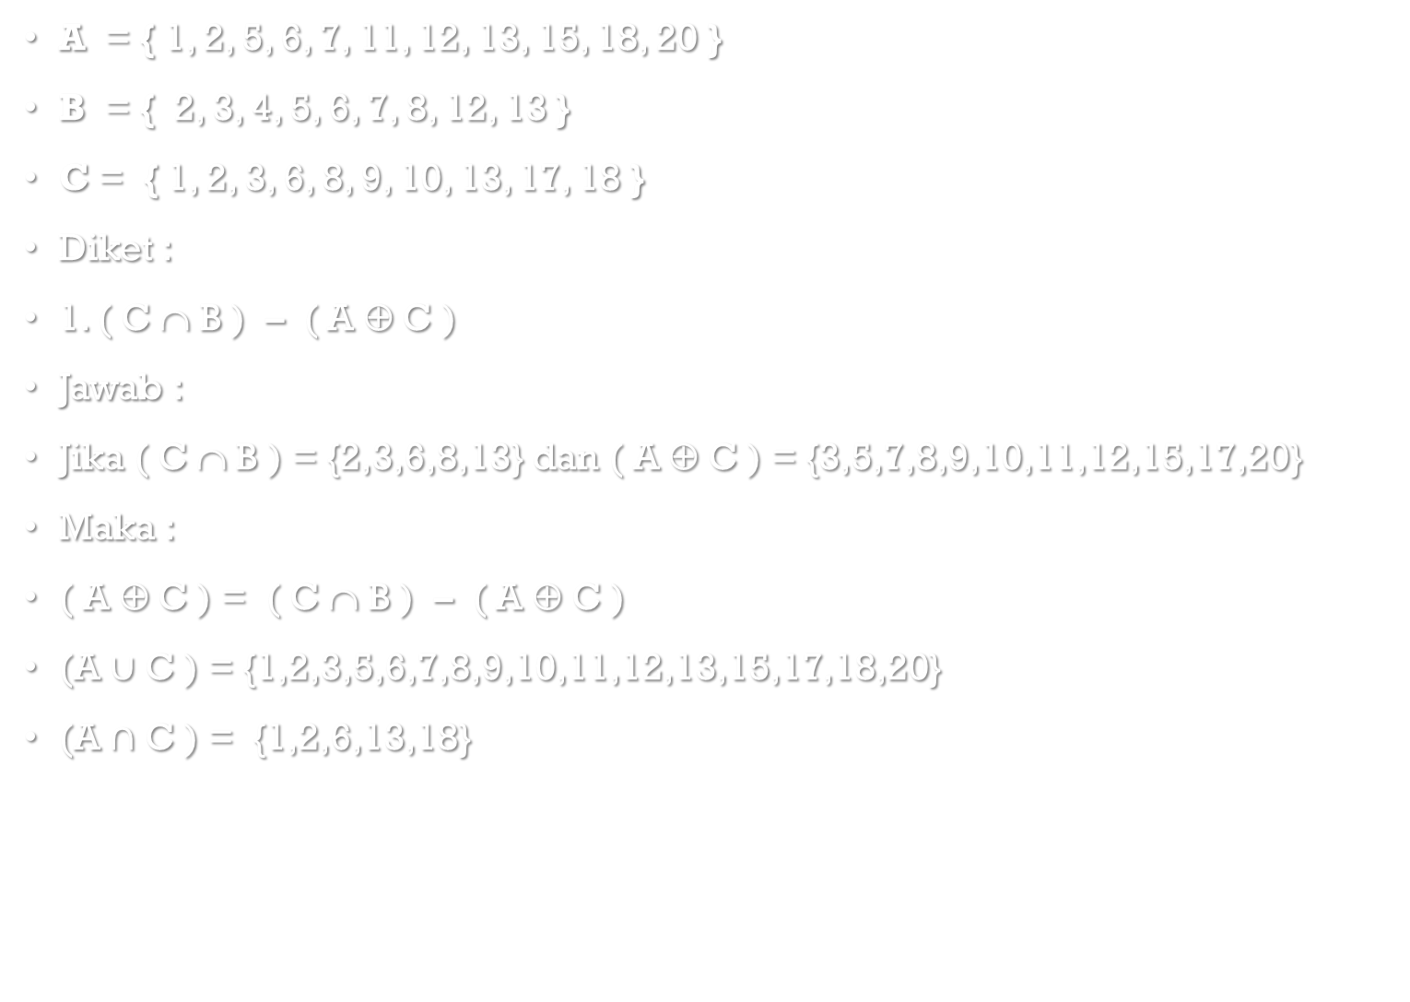
A = { 1, 2, 5, 6, 7, 11, 12, 13, 15, 18, 20 }
B = { 2, 3, 4, 5, 6, 7, 8, 12, 13 }
C = { 1, 2, 3, 6, 8, 9, 10, 13, 17, 18 }
Diket :
1. ( C ∩ B ) – ( A ⊕ C )
Jawab :
Jika ( C ∩ B ) = {2,3,6,8,13} dan ( A ⊕ C ) = {3,5,7,8,9,10,11,12,15,17,20}
Maka :
( A ⊕ C ) = ( C ∩ B ) – ( A ⊕ C )
(A $∪$ C ) = {1,2,3,5,6,7,8,9,10,11,12,13,15,17,18,20}
(A $∩$ C ) = {1,2,6,13,18}

Slide 10
A = { 1, 2, 5, 6, 7, 11, 12, 13, 15, 18, 20 }
B = { 2, 3, 4, 5, 6, 7, 8, 12, 13 }
C = { 1, 2, 3, 6, 8, 9, 10, 13, 17, 18 }
Diket :
2. ( A – B ) ⊕ ( C ∩ B )
Jawab :
Jika (A – B ) - ( C ∩ B ) = {1,11,15,18,20} dan ( C ∩ B ) - (A – B ) = {2,3,6,8,13}
Maka hasilnya dalam ⊕ adalah = {1,2,3,6,8,13,15,18,20}

Slide 11
Selesai

